Slide 1



DEPRTAMENT OF COMPUTER OF SCIENCE & ENGINEERING
SCHOOL OF COMPUTING
10214CS501 / COMMUNITY SERVICE PROJECT
WINTER SEMESTER(2024-2025)
INITIAL REVIEW
“DEPLOYMENT OF MEDIBOT IN HEALTHCARE”
PRESENTED BY
1. S.NAVEEN (VTU 26282) (23UECS0994)
2.P.PAVAN KUMAR (VTU26778) (23UECS0435)
3.Y.VENU MADHAV REDDY (VTU26287) (23UECS0996)
PROJECT SUPERVISOR
DR.P.RAJESH

Slide 2
PROJECT TITLE JUSTIFICATION
. Medi bot is a chatbot that uses Natural Language Processing (NLP) by text format and is supported by AI and Deep Learning for Medical Diagnostics.
. The goal of the project is to create a Medi bot that overcomes the proposed methodology. Many people
could not meet the doctors for simple problems such as cold and fever.
. To reduce these cases, Medi bot can communicate with the patients and understand the symptoms, and also provide them with medicines. The scope of deploying Medi bot in healthcare is to provide medical assistance to patients remotely and reduce physical contact.
. The proposed methodology is to implement Medi bot in hospitals to help people from the spread of
diseases and reduce the physical contact.
. Medi bot can provide medical advice to doctors and patients about what to do in certain cases, which ultimately results in
saving the lives of hundreds of people.
. The AI-based medical chatbot can take decisions as per the request of the patient by using its database.
. Through chatbots, one can speak with text or voice interface and get answers through AI.
. Chatbots are programs built to automatically work on the received messages. Increasing numbers of hospitals, nursing homes, and private centers are already using online chatbots for healthcare on their sites.
. This is a great step towards providing medical assistance to patients remotely and reducing physical contact.

Slide 3
OBJECTIVE&SCOPE
Aim of the Project: The aim of deploying Medi bot in healthcare is to reduce physical contact and help people from the spread of diseases.
Scope of the Project: The scope of deploying Medi bot in healthcare is to provide medical assistance to patients remotely and reduce physical contact.
Medi bot is a chatbot that uses Natural Language Processing (NLP) by text format and is supported by AI and Deep Learning for Medical Diagnostics.
The proposed methodology is to implement Medi bot in hospitals to help people from the spread of diseases and reduce the physical contact .
The goal of the project is to create a Medi bot that over comes the proposed methodology.
Many people could not meet the doctors for simple problems such as cold and fever. To reduce these cases, Medi bot can communicate with the patients and understand the symptoms, and also provide them with medicines

Slide 4

TOOLS TO BE USED IN THE PROJECT
PROGRAMMING LANGUAGE USED
Java, python
TECHNOLOGIES USED
Natural language Processing
Machine Learning Models
Cloud based Infrastructure
Interperable Health Data Systems
HIPAA Compliance &Data Security
API integrations
Speech Recognition

Slide 5
SOCIETAL IMPORTANCE OF THE PROJECT
. Deploying a Medi bot is not an easy task in the healthcare.
. Medi bot is an AI-powered chatbot that provides medical advice and assistance to patients.
. While Medi bot has the potential to improve access to healthcare and reduce the burden on healthcare systems, it also raises several societal problems.
. One of the most pressing problems is the potential for misdiagnosis. Medi bot relies on algorithms to
diagnose medical conditions, which may not always be accurate.
. This can lead to incorrect diagnoses and inappropriate treatment, which can have serious consequences for patients.
. In addition, the use of AI in healthcare raises concerns about data privacy and security.
. Medi bot collects sensitive medical information from patients, which must be protected from unauthorized access and misuse.
. Finally, the use of AI in healthcare raises ethical concerns about bias and discrimination.
. AI algorithms may be biased against certain groups of people, such as people of color or people with
disabilities, which can lead to disparities in healthcare outcomes.

Slide 6
TIMELINE OF THE PROJECT
GANTT CHART
TASK NAME | DEC 2024 | JAN 2025 | FEB 2025 | MARCH 2025 | APRIL 2025
PLANNING
RESEARCH
DESIGN
DEVELOPMENT
TESTING

Slide 7
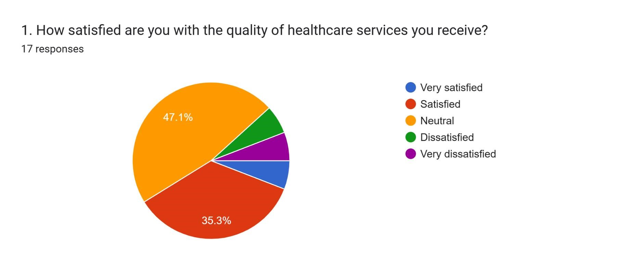
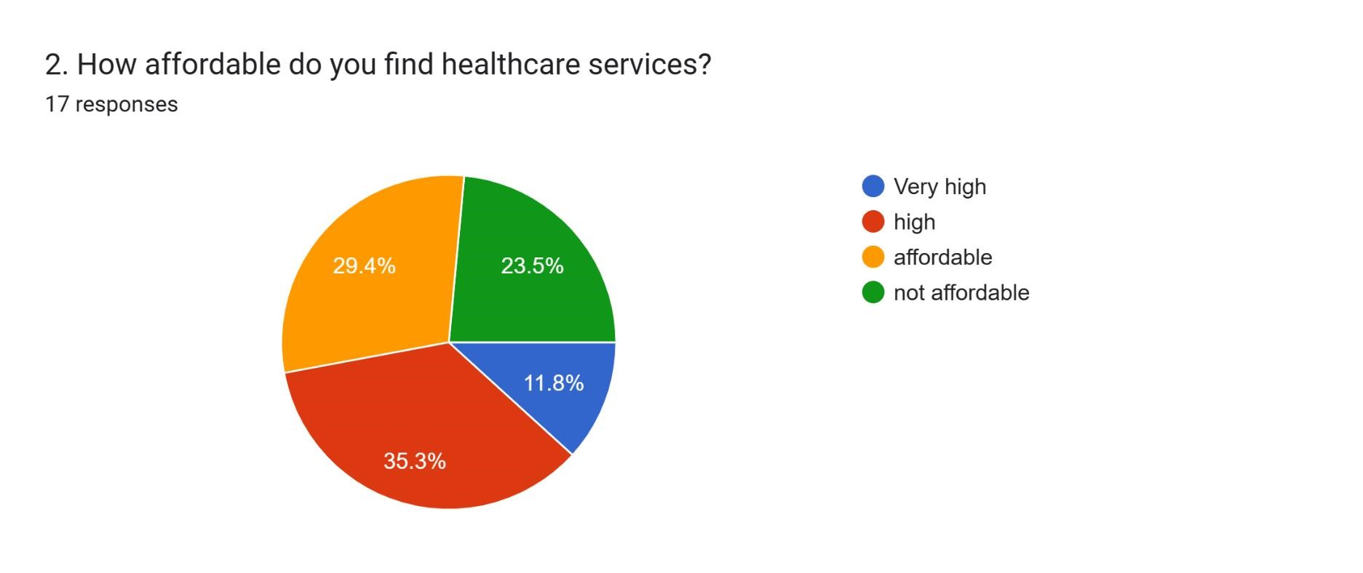
SURVEY ANALYSIS

Slide 8
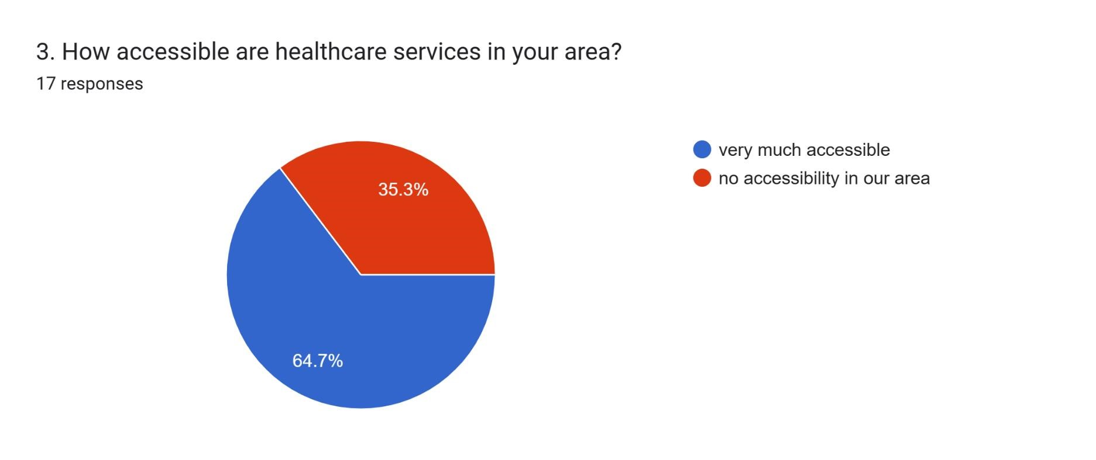
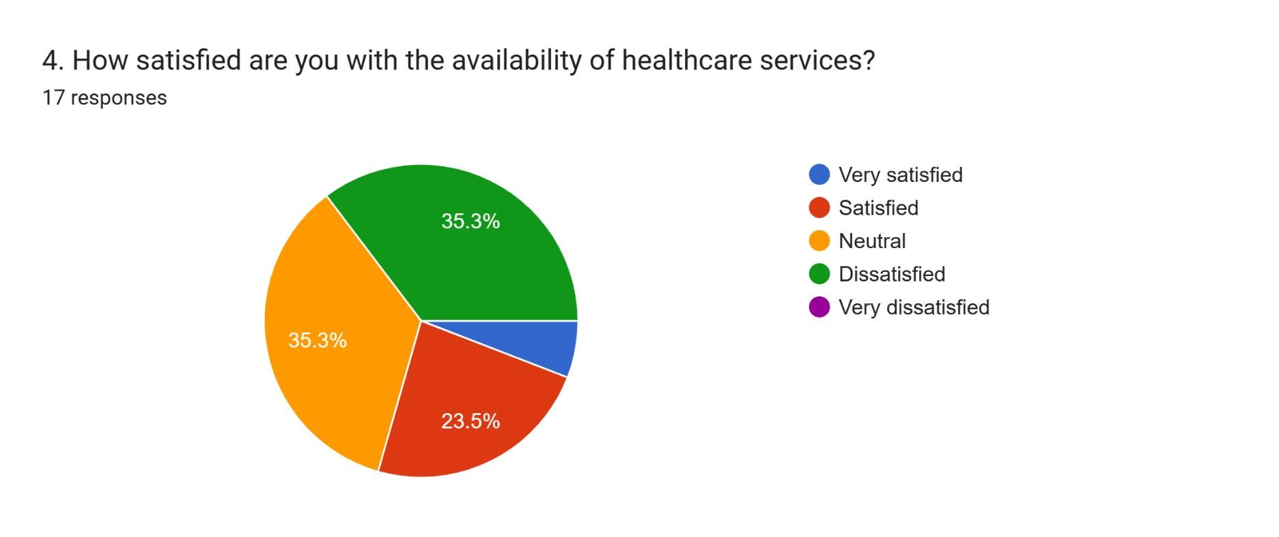
SURVEY ANALYSIS

Slide 9
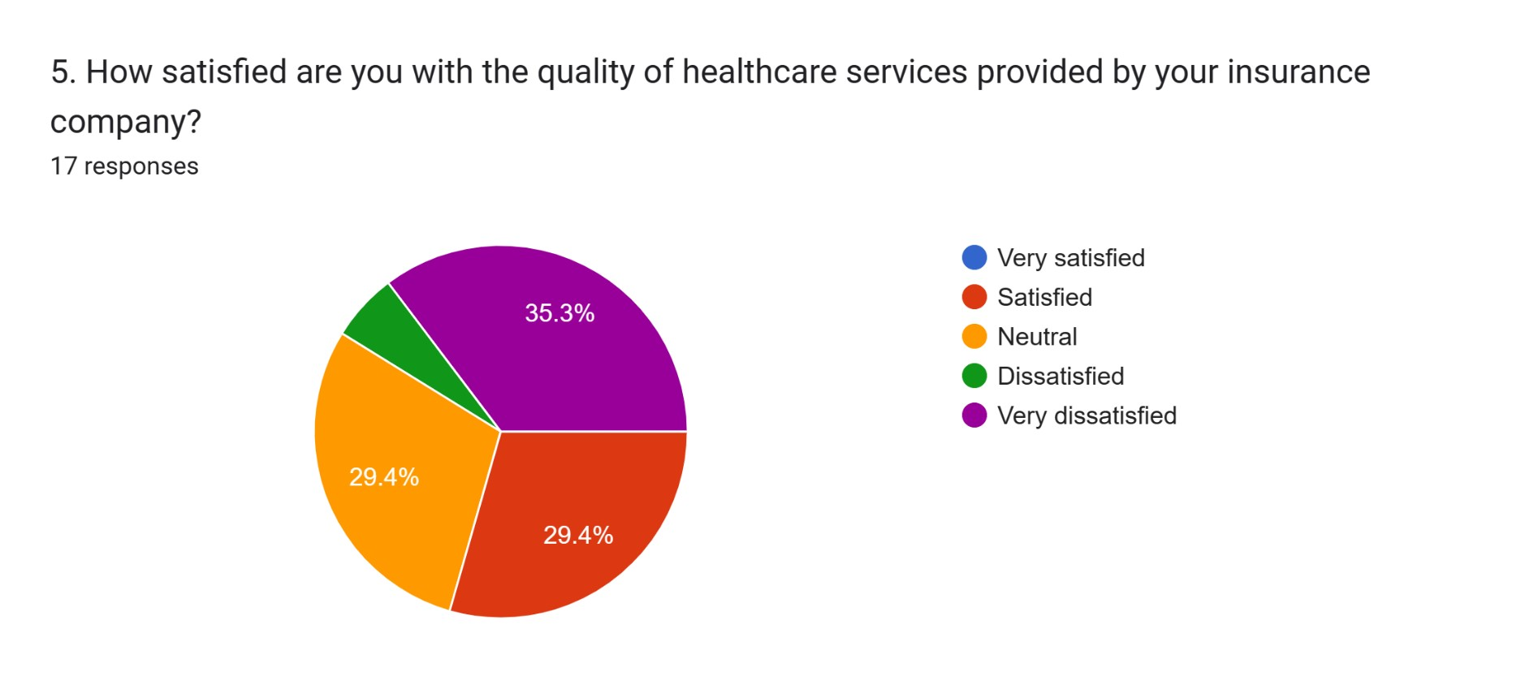
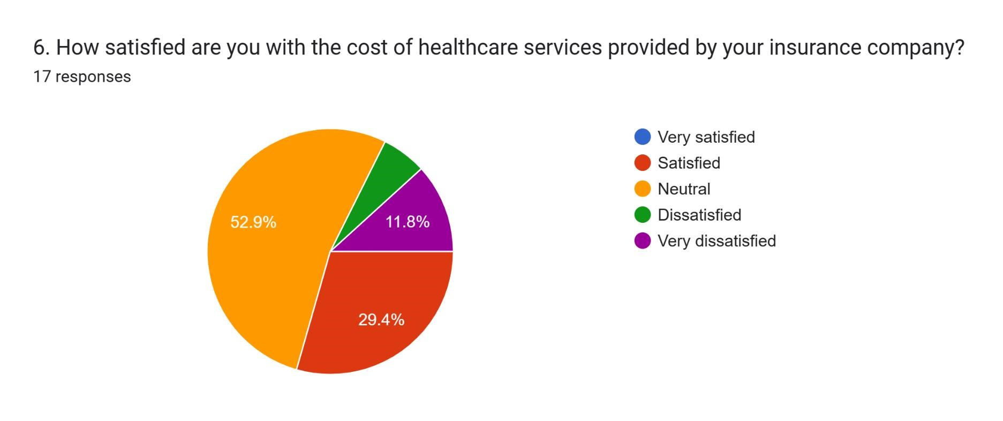

Slide 10
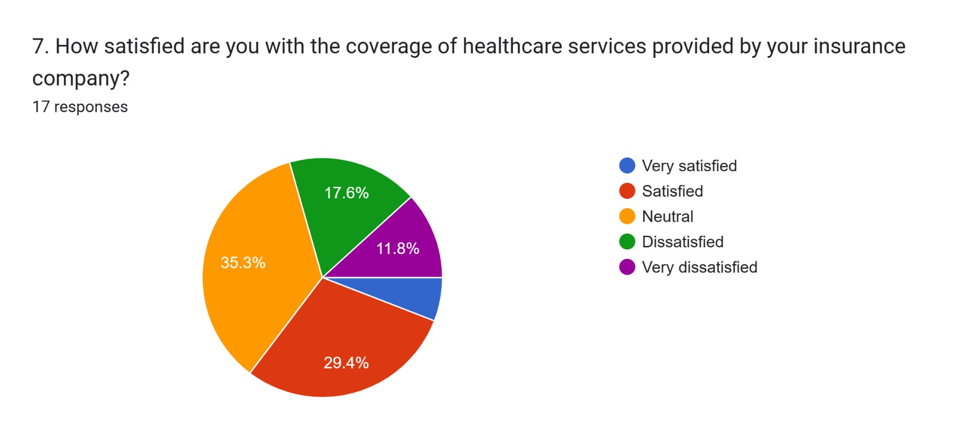
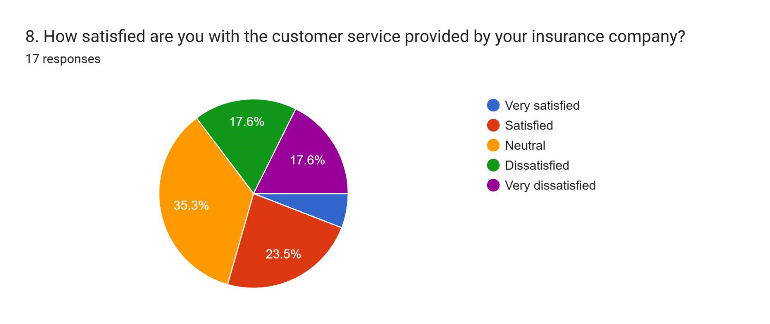

Slide 11
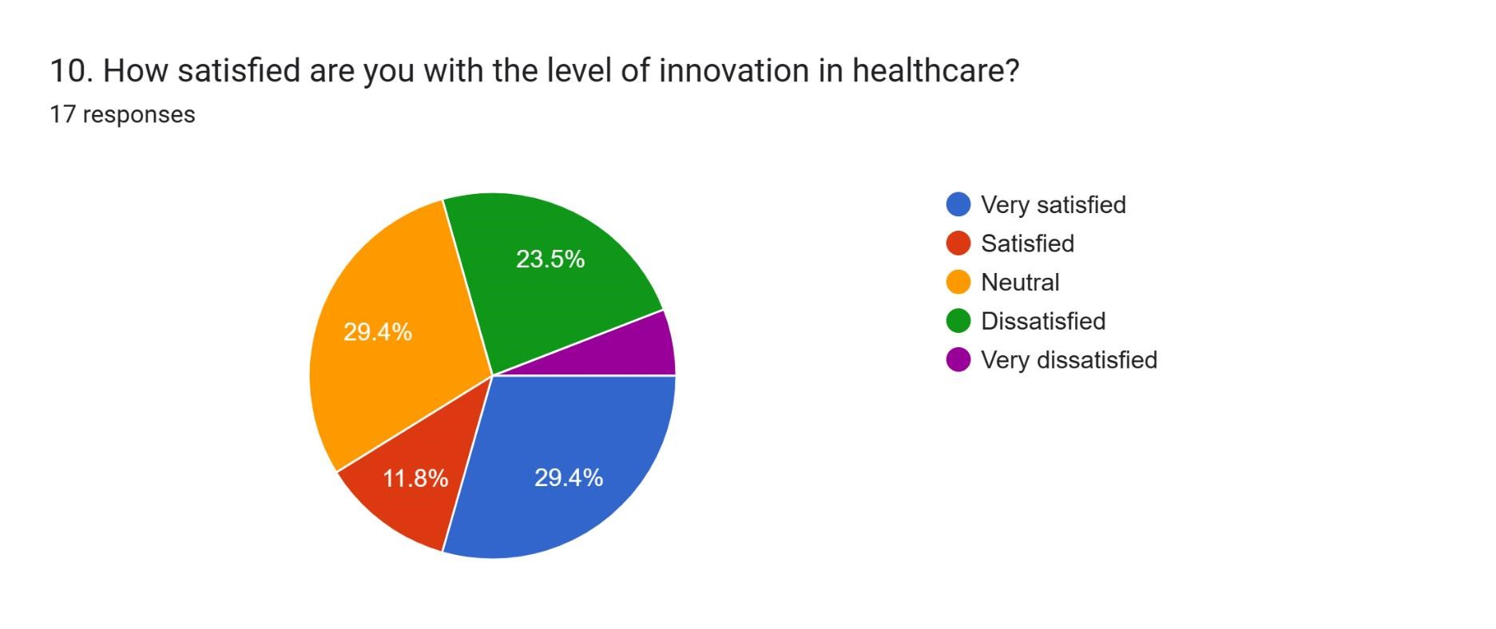
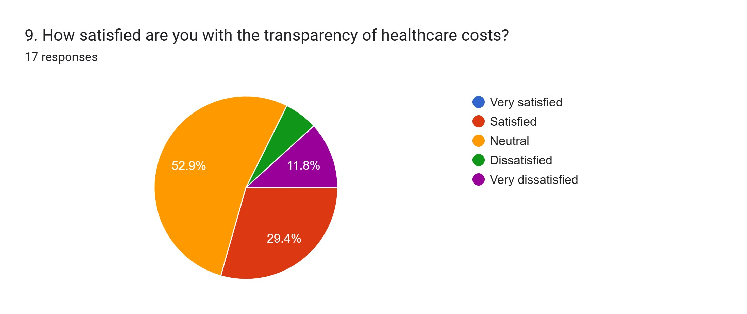

Slide 12
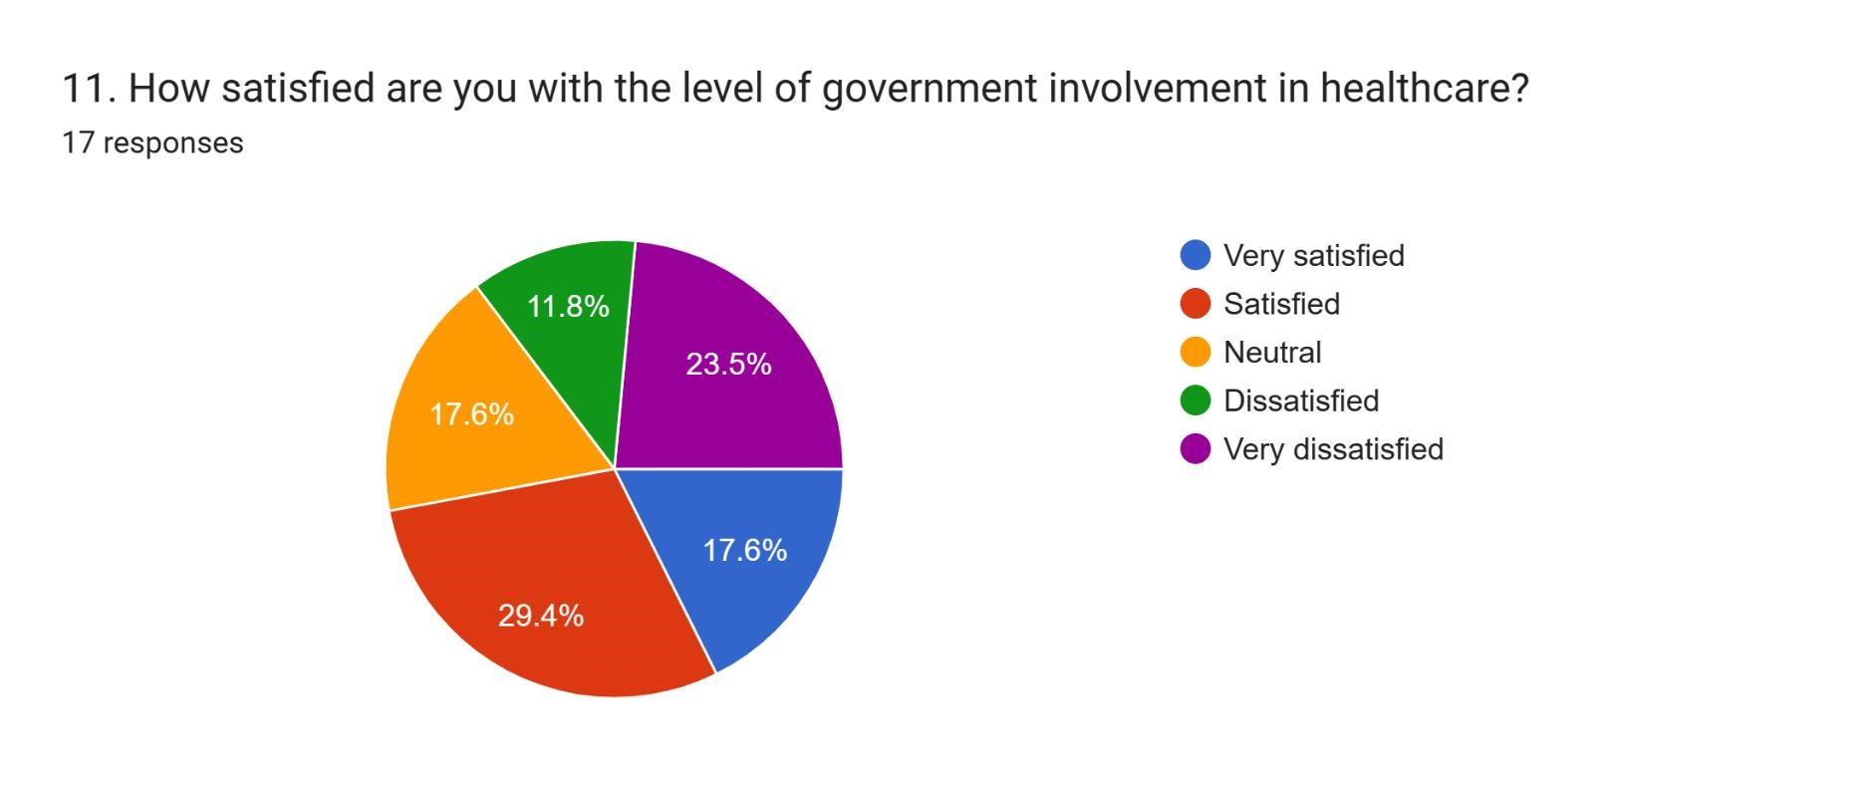
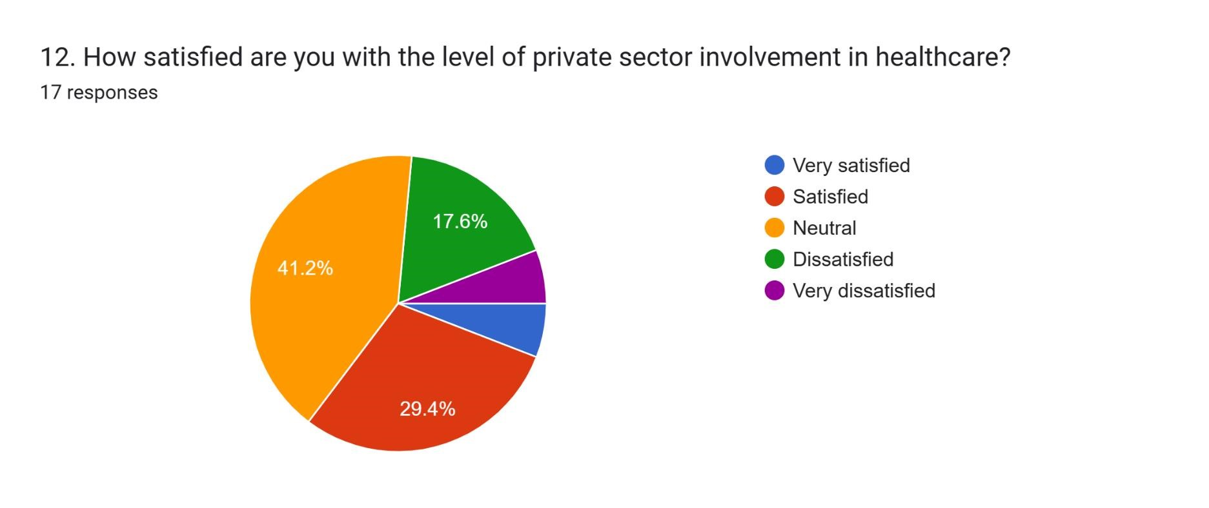

Slide 13
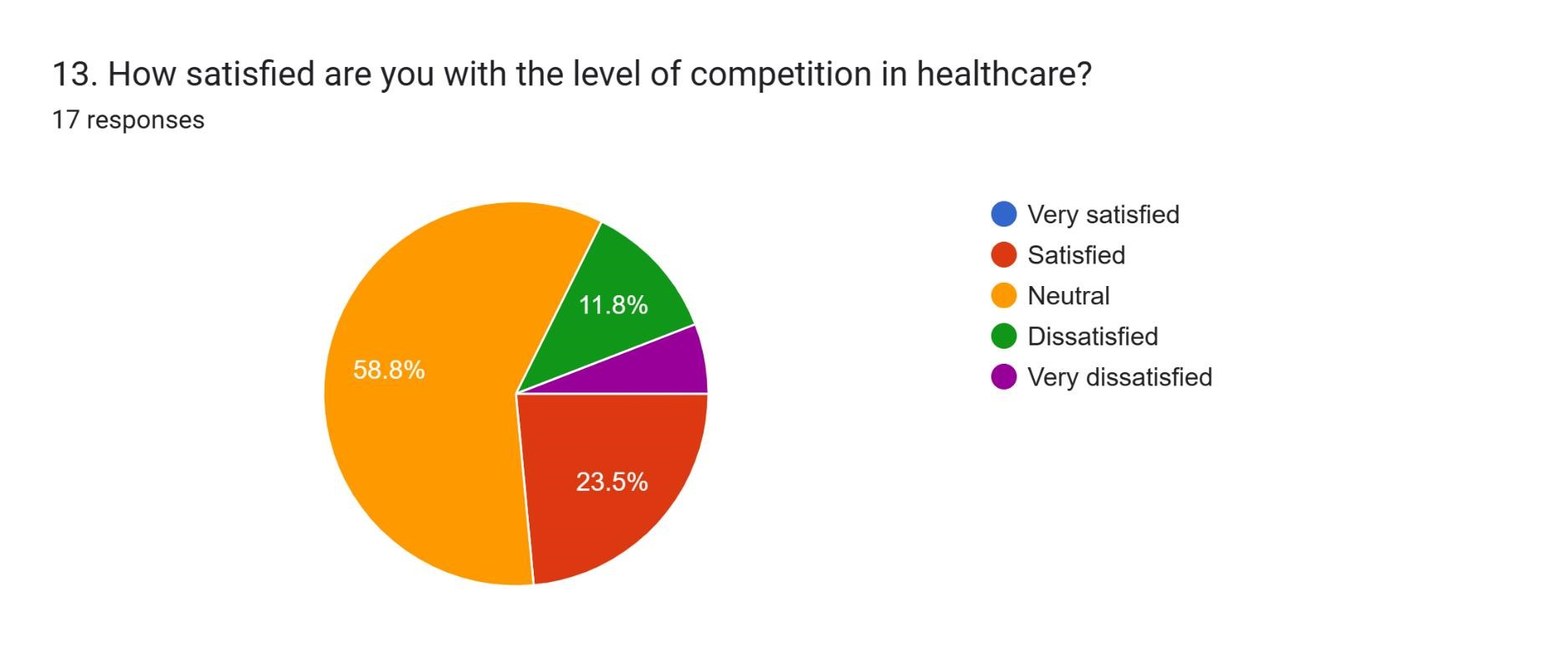
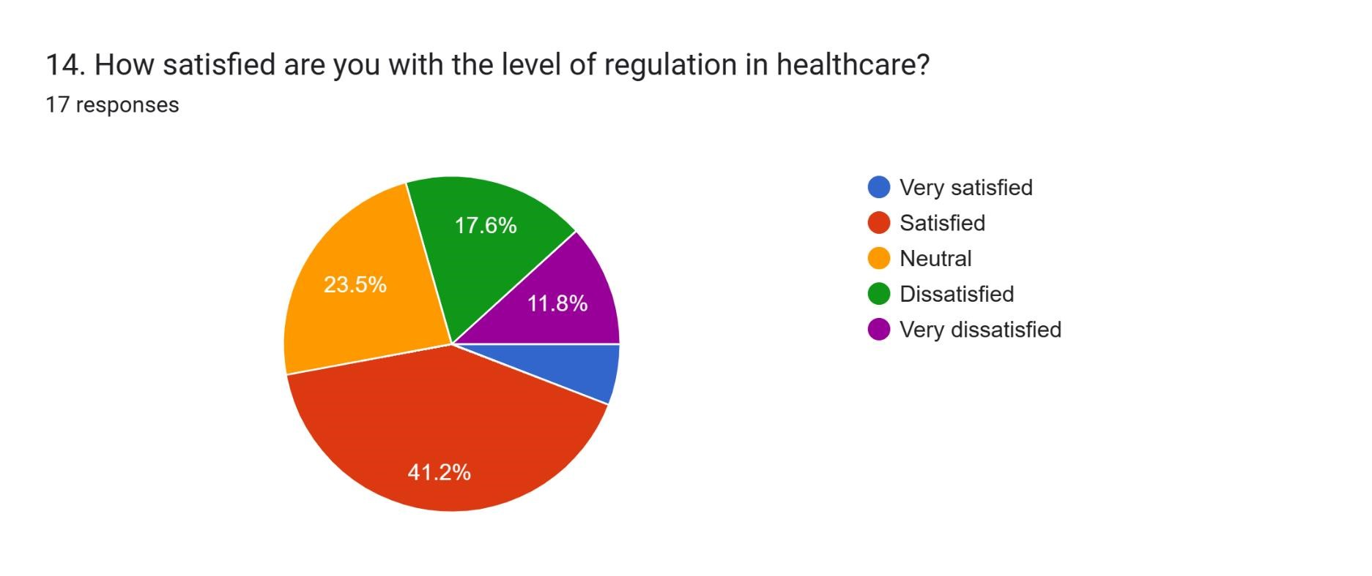
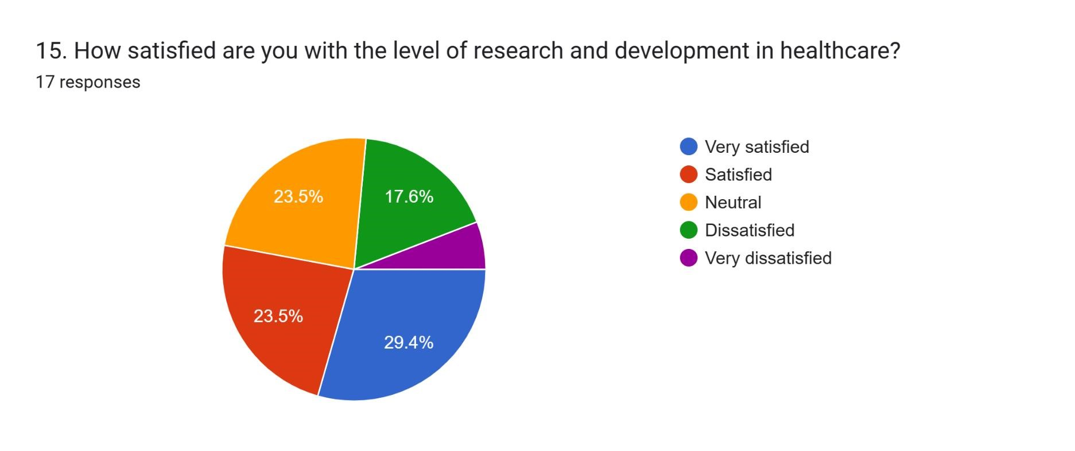

Slide 14
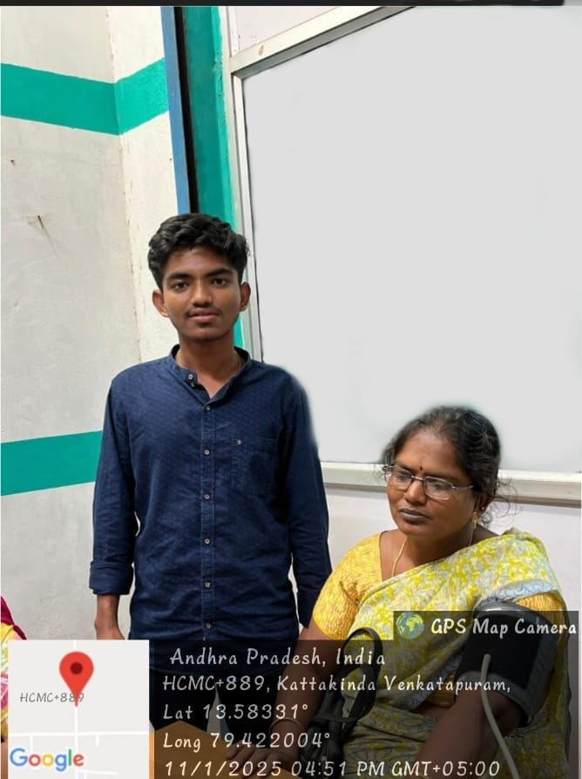
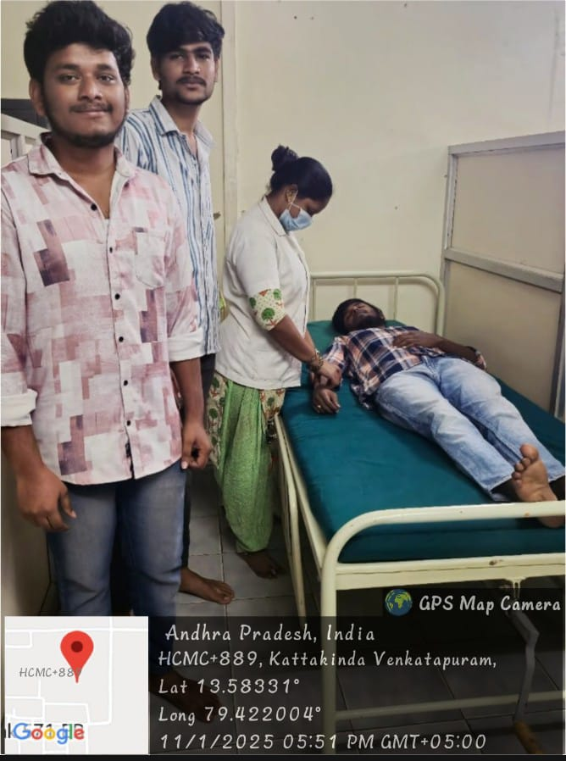

Slide 15
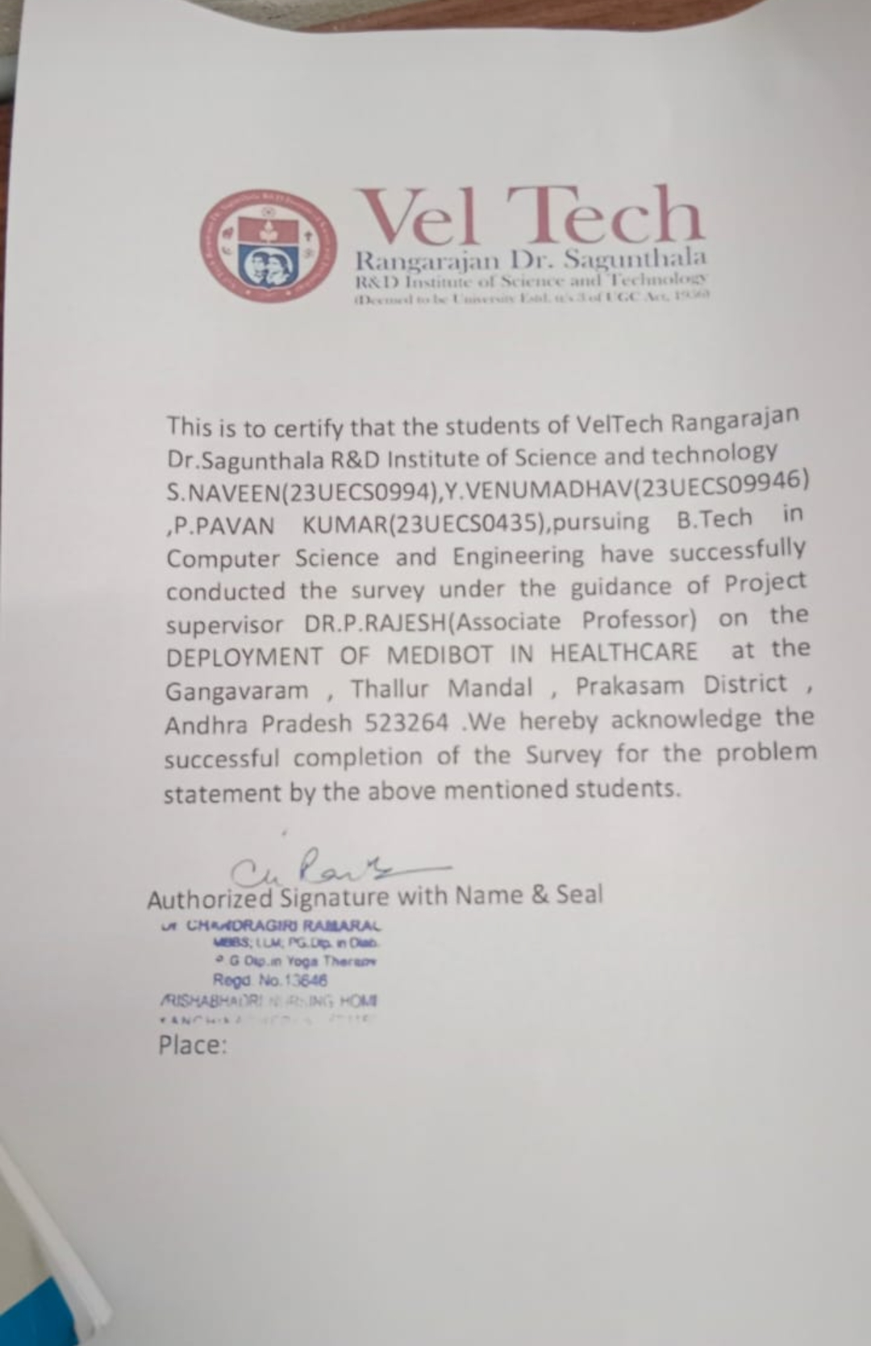
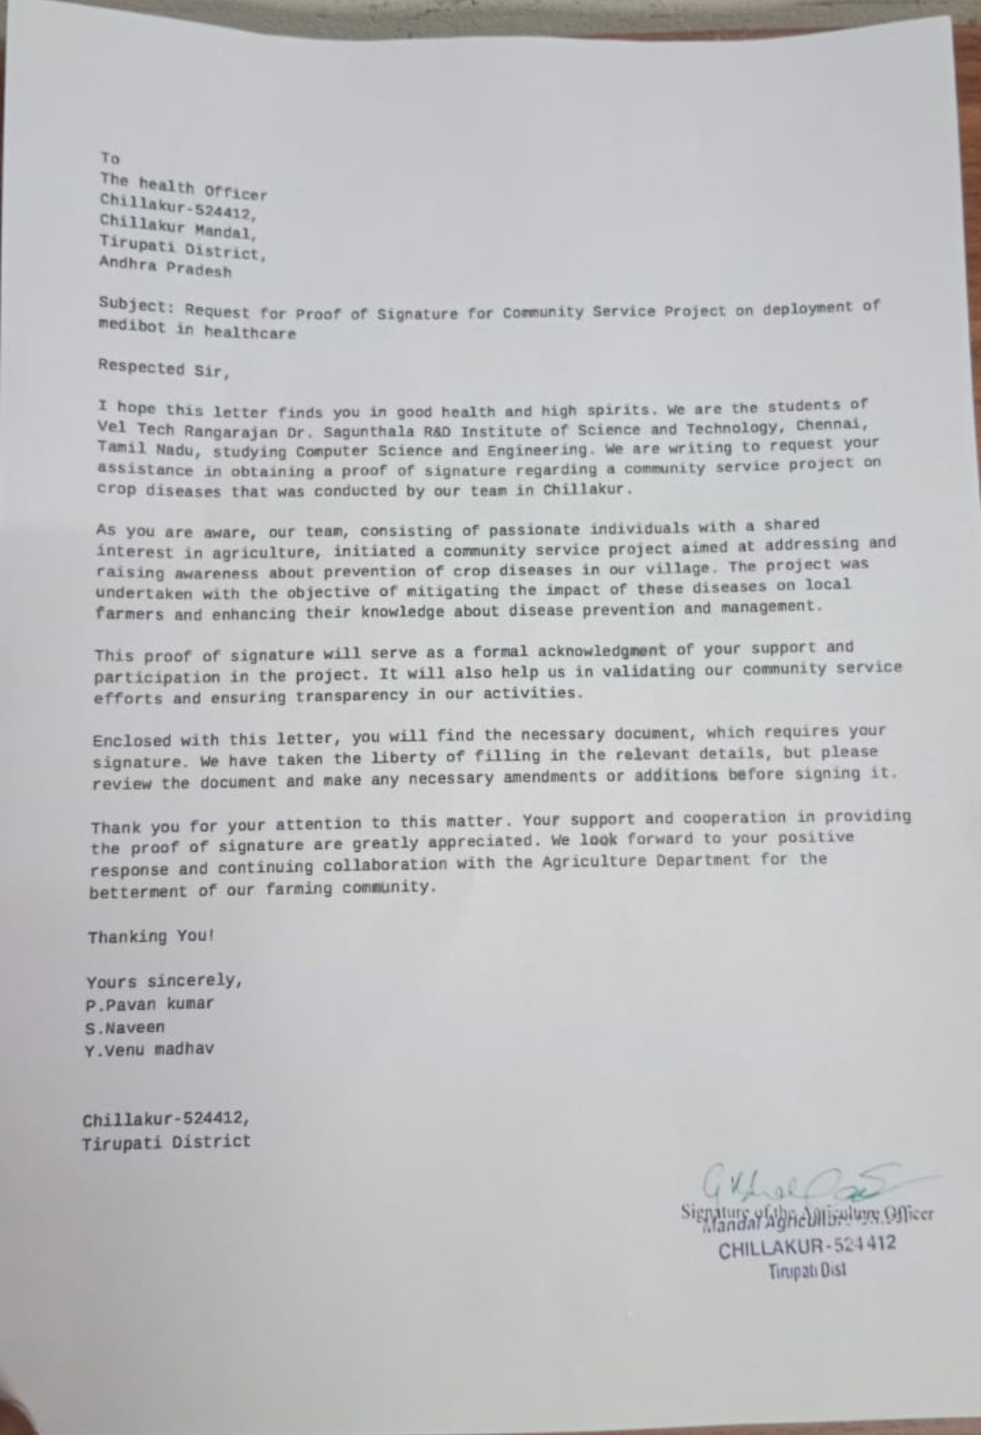

Slide 16

THANK YOU

